Slide 1



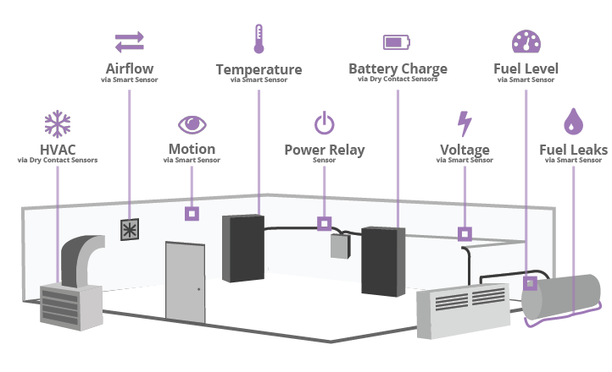
Pranjal Arya ( 16bec105 ) Mrunal Pancholi ( 16bec130 ) Guide: Dr. Vijay Savani
Smart Power Supply Monitoring, Logging, and Alerting System
This Photo by Unknown Author is licensed under CC BY-SA

Slide 2
∙ Title ∙ Motivation ∙ Objectives ∙ System Block Diagram ∙ Timeline ∙ Tools and Technology ∙ Features ∙ Applications & Advantages ∙ Cost Analysis ∙ Future Scope ∙ Reference
Outline ( Topic covered )

Slide 3
∙ Costly and system dependent products available in market ∙ Continuous monitoring required ∙ Immediate and safe shutdown of system with notification ∙ No loss of data at shutdown ∙ Designing a product which can be directly implemented on servers on Nirma University
Motivation

Slide 4
∙ To design & Develop smart power monitoring system ∙ To design sensor network ∙ To develop data logger, monitor, and alerting system with GUI ∙ To integrate the server with communication system ∙ To design database to store condition of system and to notify authority
Objective

Slide 5
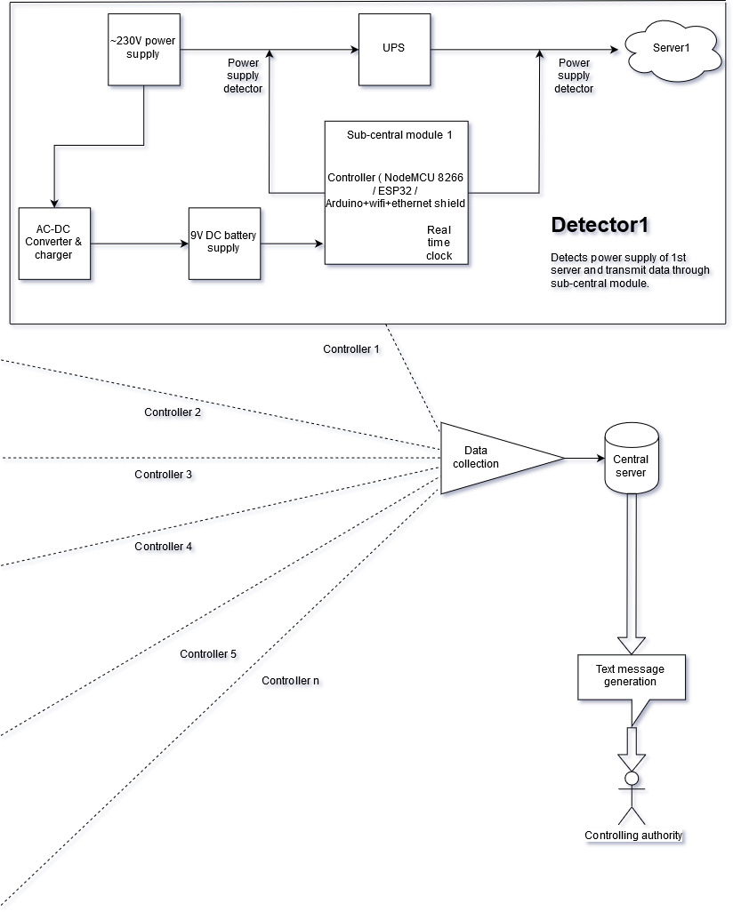
Block Diagram

Slide 6
Tools
Technologies
∙ ESP32 ∙ Real Time Clock ( DS3231 ) ∙ LCD display (16*2) ∙ Current sensor ( acs712, SCT013-030 )
∙ PM01 AC-DC Power module
∙ Rechargeable Lithium battery module
∙ Arduino 1.8.5
∙ C/C++
∙ MySQL
∙ PHP/HTML/CSS

Slide 7
Timeline
Connect various sensors
Managing files with DBMS
Connection with notification system
Integrating real time clock
Designing power supply
Generating log files and storing

Slide 8
Work done
Issues faced
Implementation of RTC, LCD module with Arduino
GPP designing for ESP32
Activation of ESP32 and integration with RTC, LCD
Library mismatch with DS3231
Issues with ESP32 board manager

Slide 9
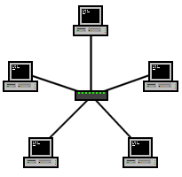
• Nirma University Servers
Applications

Slide 10
• Low cost and system independent • Compact in design and easy to operate • Allows control and monitoring of multiple UPSs via LAN and WIFI UPS Navigation • Real-time dynamic graphs of UPS data • Safely OS shutdown and protection from data loss during power failure • Warning notifications via pop-up screen or e-mail/SMS • Password security protection and Remote access management Tracking through Mobile • It can monitor and manage from one to multiple UPSs in a networked environment, either LAN or INTERNET • prevent data loss from power outage and safely store programming data and scheduled shutdown UPSs.
Features

Slide 11
Cost Analysis
Competitors
IBM power executive
Oracle ILOM
Zabbix ( No cost )
What differentiate us from others…
Low Cost
Small size
User friendly software without need of a skilled user
Factor | Price
ESP32 | 250 INR
Sensors | 1200 INR
Real time clock | 200 INR
Power supply system | 2000 INR
Integration with database and notification system & miscellaneous | 1000 INR
Final ( per module ) | 4470 INR

Slide 12
Reference ( IEEE format )
[1] arduino.cc . [online]. Available:https://www.arduino.cc/reference. [Accessed: 20- Feb- 2019]
[2] datasheets.maximintegrated.com. [online].Available:https://datasheets.maximintegrated.com/en/ds/DS1302.pdf.[Accessed: 03- Feb- 2019]
[3] citethisforme.com. [online]. Available:http://www.citethisforme.com/guides/ieee/how-to- cite-a-website. [Accessed: 05- Feb- 2019]
[4] Robokits.co.in. [online]. Available: https://robokits.co.in/sensors/current-sensor/current-sensor-module-20a-acs712. [Accessed: 18- Feb- 2019]

Slide 13
Thank You!

